Slide 1


Today’s Contents
Sharpening spatial filtering
1st derivative filters
2nd derivative filters
Derivatives of Image
Laplacian Filter
Laplacian Image Enhancement
Difference filters
Combining filtering techniques
Chapter 3 from R.C. Gonzalez and R.E. Woods, Digital Image Processing
(3rd Edition), Prentice Hall, 2008 [ Section 3.6, 3.7 ] https://www.quora.com/How-can-we-find-the-shortest-m-connected-path-if-
the-pixel-values-are-given-in-matrix-form http://www.cse.iitm.ac.in/~vplab/courses/CV_DIP/PDF/NEIGH_CONN.pdf

Slide 2
Sharpening Spatial Filters
Previously we have looked at smoothing filters which remove
fine detail
Sharpening spatial filters seek to highlight fine detail
Remove blurring from images
Highlight edges
Sharpening filters are based on spatial differentiation
DIP, Spring 2012 GS & AS, Bahria University, Islambad

Slide 3
Spatial Differentiation
Sharpening filters are based on first- and second-order derivatives of image.
The derivatives of a digital function are defined in terms of differences.
i.e. Sharpening filters are based on spatial differentiation
DIP, Spring 2012 GS & AS, Bahria University, Islambad

Slide 4
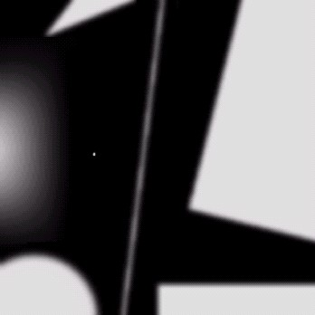
Spatial Differentiation
Let’s consider a simple 1 dimensional example
DIP, Spring 2012 GS & AS, Bahria University, Islambad

Slide 5
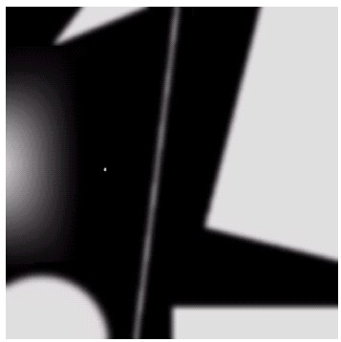
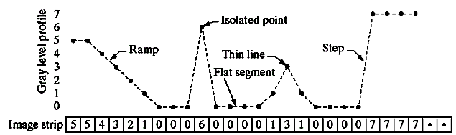
Spatial Differentiation
A B
DIP, Spring 2012 GS & AS, Bahria University, Islambad

Slide 6

1st Derivative
The 1st derivative of a function is given by:
^{∂f} = f (x +1) − f (x)
∂x
Its just the difference between subsequent values and measures the rate of change of the function
DIP, Spring 2012 GS & AS, Bahria University, Islambad

Slide 7


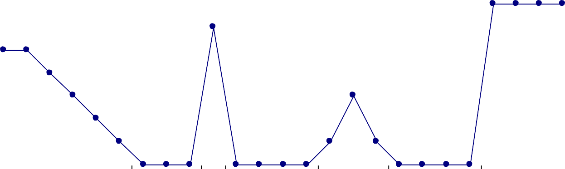
1st Derivative
8
7
6
5
4
3
2
1
0
5 | 5 | 4 | 3 | 2 | 1 | 0 | 0 | 0 | 6 | 0 | 0 | 0 | 0 | 1 | 3 | 1 | 0 | 0 | 0 | 0 | 7 | 7 | 7 | 7
 | -1 | -1 | -1 | -1 | -1 | 0 | 0 | 6 | -6 | 0 | 0 | 0 | 1 | 2 | -2 | -1 | 0 | 0 | 0 | 7 | 0 | 0 | 0
8
6
4
2
0
-2
-4
-6
-8
DIP, Spring 2012 GS & AS, Bahria University, Islambad

Slide 8

2nd Derivative
The 2nd derivative of a function is given by:
∂² f ₌
f (x +1) + f (x −1) − 2 f (x)
∂² x
Simply takes into account the values both before and after the current value
DIP, Spring 2012 GS & AS, Bahria University, Islambad

Slide 9


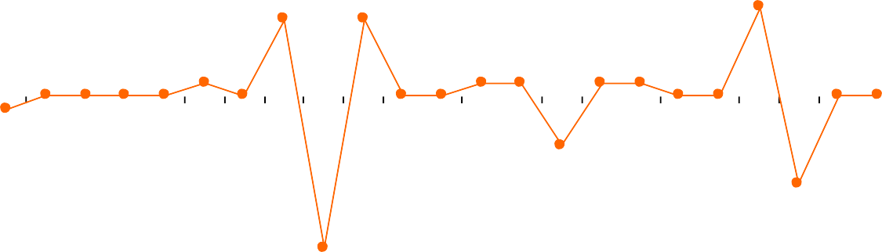
2nd Derivative
8
7
6
5
4
3
2
1
0
5 | 5 | 4 | 3 | 2 | 1 | 0 | 0 | 0 | 6 | 0 | 0 | 0 | 0 | 1 | 3 | 1 | 0 | 0 | 0 | 0 | 7 | 7 | 7 | 7
 | -1 | 0 | 0 | 0 | 0 | 1 | 0 | 6 | -12 | 6 | 0 | 0 | 1 | 1 | -4 | 1 | 1 | 0 | 0 | 7 | -7 | 0 | 0
10
5
0
-5
-10
-15
DIP, Spring 2012 GS & AS, Bahria University, Islambad

Slide 10

2nd Derivative for Image
Enhancement
The 2nd derivative is more useful for image enhancement
than the 1st derivative - Stronger response to fine detail
We will come back to the 1st order derivative later on
The first sharpening filter we will look at is the Laplacian
DIP, Spring 2012 GS & AS, Bahria University, Islambad

Slide 11
Laplacian Filter
The Laplacian is defined as follows:
∂² f ∂² f ^{f =} ∂² x ⁺ ∂² y
∇2
^{∂2 f} = + + − −
f (x 1, y) f (x 1, y) 2 f (x, y)
∂² x
∂² f ₌
f (x, y +1) + f (x, y −1) − 2 f (x, y)
∂² y
DIP, Spring 2012 GS & AS, Bahria University, Islambad

Slide 12


Laplacian Filter
So, the Laplacian can be given as follows:
∇² f = [ f (x +1, y) + f (x −1, y)
+ f (x, y +1) + f (x, y −1)]
− 4 f (x, y)
0 | 1 | 0
1 | -4 | 1
0 | 1 | 0
Can we implement it using a filter/ mask?
DIP, Spring 2012 GS & AS, Bahria University, Islambad

Slide 13
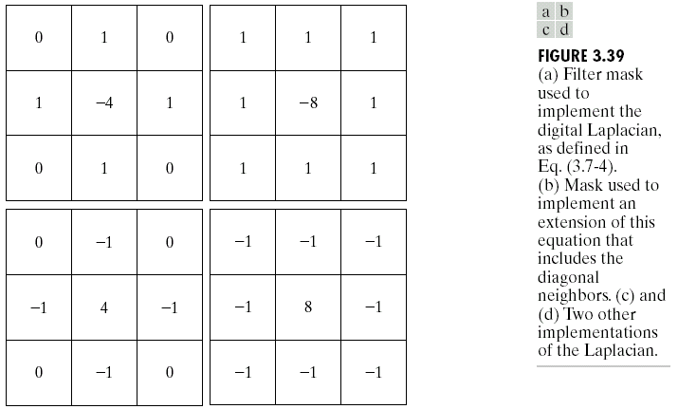
Laplacian Filter
DIP, Spring 2012 GS & AS, Bahria University, Islambad

Slide 14
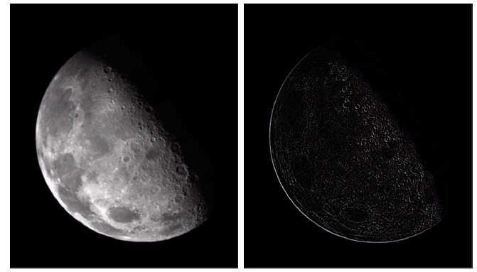
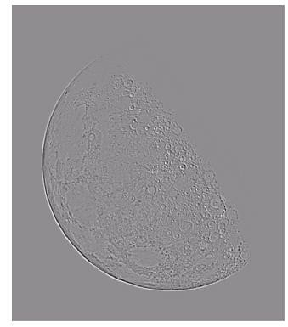
Laplacian Filter
Applying the Laplacian to an image we get a new image that highlights edges and other discontinuities
Original Image
Laplacian Filtered Image
Laplacian Filtered Image
Scaled for Display
DIP, Spring 2012 GS & AS, Bahria University, Islambad

Slide 15



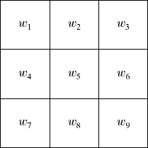
Laplacian Image Enhancement
The result of a Laplacian filtering is not an
enhanced image
To generate the final enhanced image
Laplacian Filtered Image
Scaled for Display
f (x, y) −∇² f , w < 0
g(x, y) =
5
f (x, y) + ∇² f , w > 0
5
DIP, Spring 2012 GS & AS, Bahria University, Islambad

Slide 16
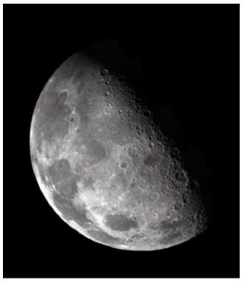
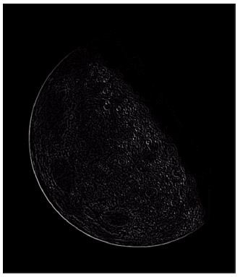
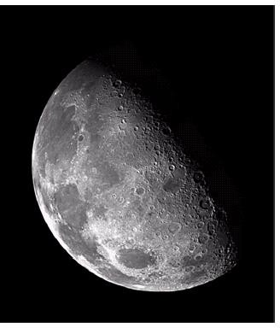
Laplacian Image Enhancement
-
=
Original Image
Laplacian Filtered Image
Sharpened Image
In the final sharpened image edges and fine
detail are much more obvious
DIP, Spring 2012 GS & AS, Bahria University, Islambad

Slide 17
Laplacian Image Enhancement
DIP, Spring 2012 GS & AS, Bahria University, Islambad

Slide 18
Simplified Image Enhancement
⬥ The entire enhancement can be combined into a single filtering operation
g(x, y) = f (x, y) − ∇² f
= f (x, y) −[ f (x +1, y) + f (x −1, y)
+ f (x, y +1) + f (x, y −1)
− 4 f (x, y)]
DIP, Spring 2012 GS & AS, Bahria University, Islambad

Slide 19


Simplified Image Enhancement
⬥ The entire enhancement can be combined into a single filtering operation
g(x, y) = f (x, y) − ∇² f
= 5 f (x, y) − f (x +1, y) − f (x −1, y)
− f (x, y +1) − f (x, y −1)
0 | -1 | 0
-1 | 5 | -1
0 | -1 | 0
We can implement it using this filter.
DIP, Spring 2012 GS & AS, Bahria University, Islambad

Slide 20
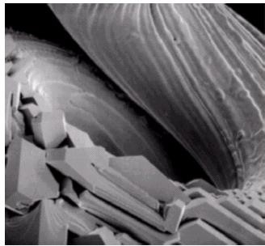
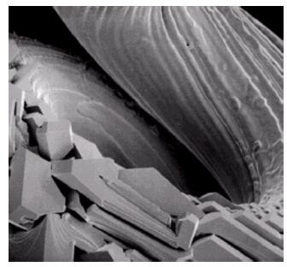
Simplified Image Enhancement
This gives us a new filter which does the whole job for us in one step
0 | -1 | 0
-1 | 5 | -1
0 | -1 | 0
DIP, Spring 2012 GS & AS, Bahria University, Islambad

Slide 21
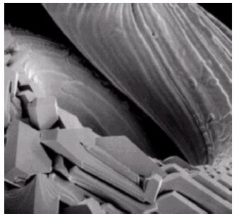
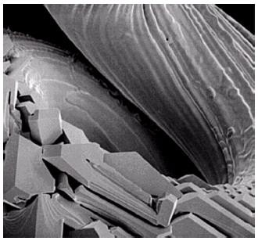
Variants On The Simple Laplacian
There are lots of slightly different versions of the Laplacian that can be used:
0 | 1 | 0
1 | -4 | 1
0 | 1 | 0
1 | 1 | 1
1 | -8 | 1
1 | 1 | 1
Simple
Laplacian
Variant of
Laplacian
-1 | -1 | -1
-1 | 9 | -1
-1 | -1 | -1
DIP, Spring 2012 GS & AS, Bahria University, Islambad

Slide 22
Use of first derivatives for image enhancement: The Gradient
The gradient vector of a function f(x,y) is defined as
⎡∂f ⎤
∇f = ^{⎡Gx ⎤} = ^{⎢∂x ⎥}
⎢_{G} ⎥
⎢_{∂f} ⎥
⎣
y ⎦
⎢_{∂y} ⎥
⎢⎣ ⎥⎦
DIP, Spring 2012 GS & AS, Bahria University, Islambad

Slide 23
Use of first derivatives for image enhancement: The Gradient
The magnitude of this vector is given by:
∇f = mag(∇f )
= [G + G ]
1
2 2
2
x
y
⎡
1
⎞2 ⎤ 2
_{= ⎢}⎛ ∂f ⎞
2
⎛
⎜ _{∂x} ⎟
+ ⎜ ^{∂f} ⎟ ⎥
⎜ _{∂y} ⎟
⎢⎣⎝ ⎠
⎝ ⎠ ⎥⎦
For practical reasons this can be simplified as:
∇f ≈ G_{x} + G_{y}
DIP, Spring 2012 GS & AS, Bahria University, Islambad

Slide 24
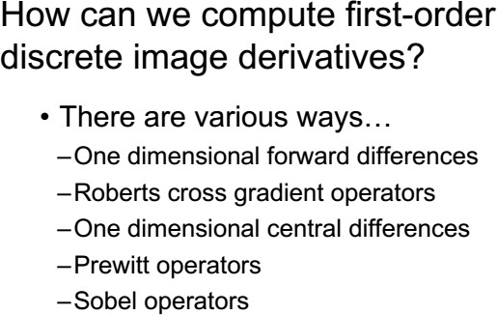
Use of first derivatives for image enhancement: The Gradient
25

Slide 25


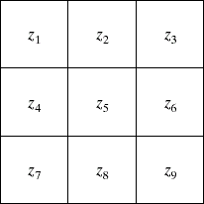
Gradient Operators
There is some debate as to how best to calculate these
gradients
Simplest Operator
^{∂f} = (z − z ), ^{∂f} = (z − z )
∂y ∂x
∇f = (z₈ − z₅ ) + (z₆ − z₅ )
2 2
x
8 5
y
6
5
∇f ≈ (z₈ − z₅ ) + (z₆ − z₅ )
DIP, Spring 2012 GS & AS, Bahria University, Islambad

Slide 26

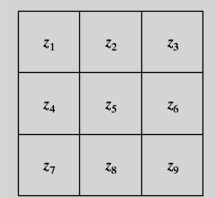

Gradient Operators
Prewitt Operator
is used for detecting edges horizontally and vertically.
+ z₉ ) − (z₁ + z₂ + z₃ )
+ (z₃ + z₆ + z₉ ) − (z₁ + z₄ + z₇ )
∇f ≈ (z₇ + z₈
Pixel Arrangement
-1 | -1 | -1
0 | 0 | 0
1 | 1 | 1
-1 | 0 | 1
-1 | 0 | 1
-1 | 0 | 1
∂f
∂f
∂y ⁼
∂x ⁼
Extract horizontal edges
Extract vertical edges
DIP, Spring 2012 GS & AS, Bahria University, Islambad

Slide 27


Gradient Operators
Sobel Operator
 |  | -2 | -1 | ∂f ₌ ∂x | -1 | 0 |  | 1
0 |  | 0 | 0 |  | -2 | 0 |  | 2
1 |  | 2 | 1 |  | -1 | 0 |  | 1
-1
∂f
∂y ⁼
Extract horizontal edges
Extract vertical edges
Emphasize more the current point (x direction)
+ z₃ )
+ z₇ )
∇f ≈ (z₇ + 2z₈ + z₉ ) − (z₁ + 2z₂
+ (z₃ + 2z₆ + z₉ ) − (z₁ + 2z₄
Emphasize more the current point (y
direction)
Pixel Arrangement
Same as Prewitt Operator
DIP, Spring 2012 GS & AS, Bahria University, Islambad

Slide 28
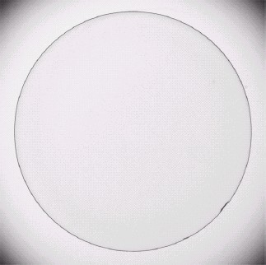
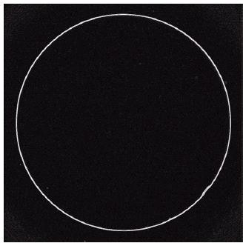
Sobel Operator: Example
An image of a contact lens which is enhanced in order to make defects more obvious
Sobel filters are typically used for edge
detection
DIP, Spring 2012 GS & AS, Bahria University, Islambad

Slide 29
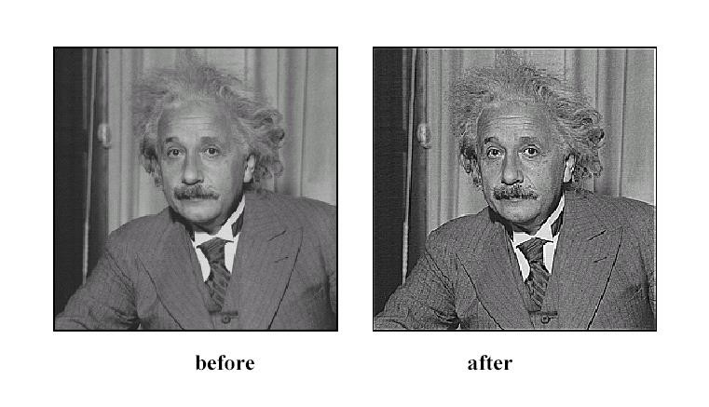
Sharpening
30

Slide 30
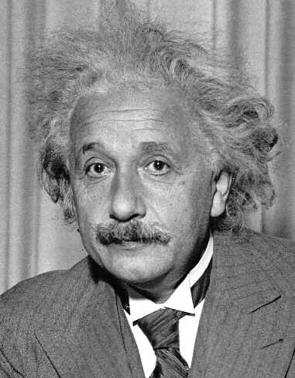
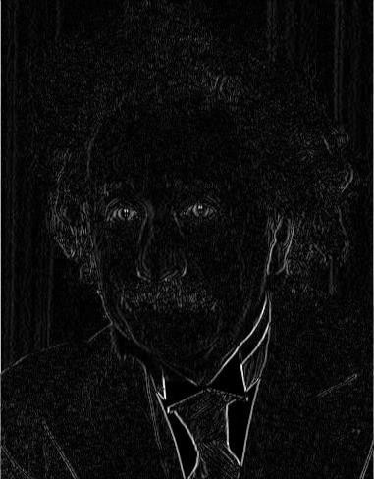
Other filters
1 | 0 | -1
2 | 0 | -2
1 | 0 | -1
Sobel
Vertical Edge
(absolute value) 31
2016/1/27

Slide 31
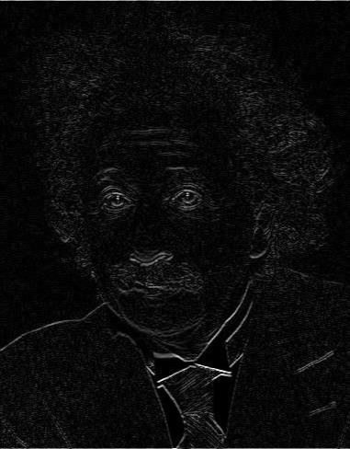
Other filters
1 | 2 | 1
0 | 0 | 0
-1 | -2 | -1
Sobel
Horizontal Edge
(absolute value) 32
2016/1/27

Slide 32
Basic gradient filters
Horizontal Gradient
Vertical Gradient
0 | 0 | 0
-1 | 0 | 1
0 | 0 | 0
0 | 1 | 0
0 | 0 | 0
0 | -1 | 0
-1
0
1
or
or
-1 | 0 | 1
2016/1/27
33

Slide 33

Difference Filter
Vertical
Horizontal
Diagonal 1
Diagonal 2
Also called as emboss filters
Enhances the details in the direction specific to the mask selected
Four primary difference filter convolution masks, corresponding to the edges in the vertical, horizontal, and two diagonal directions are:
DIP, Spring 2012 GS & AS, Bahria University, Islambad 34

Slide 34
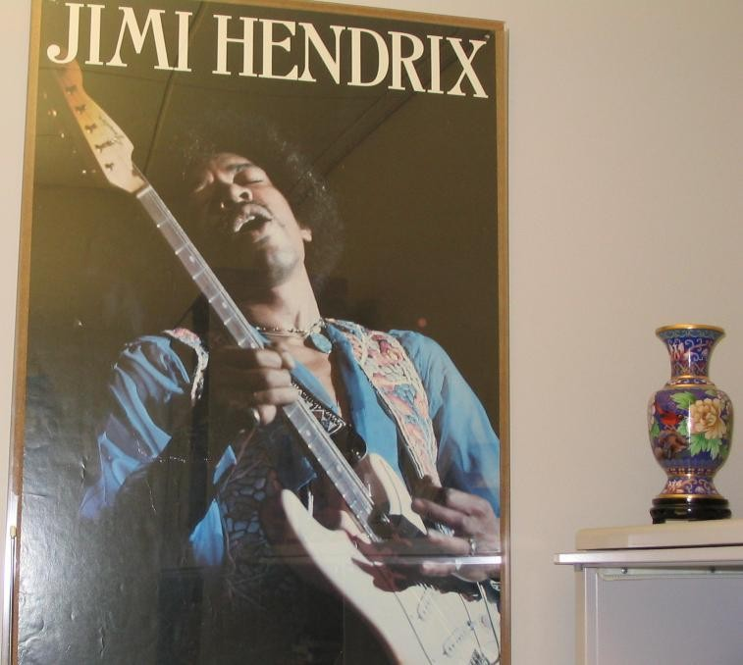
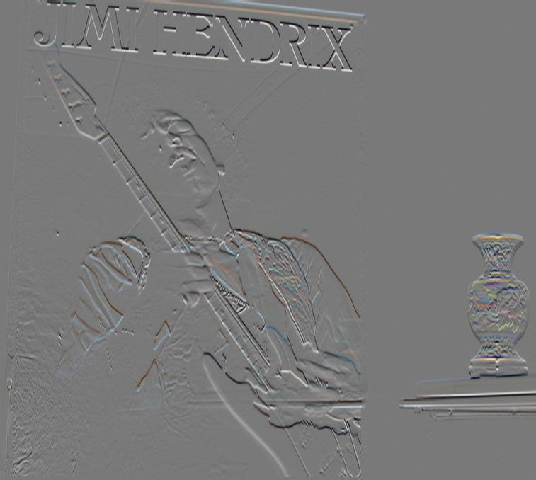
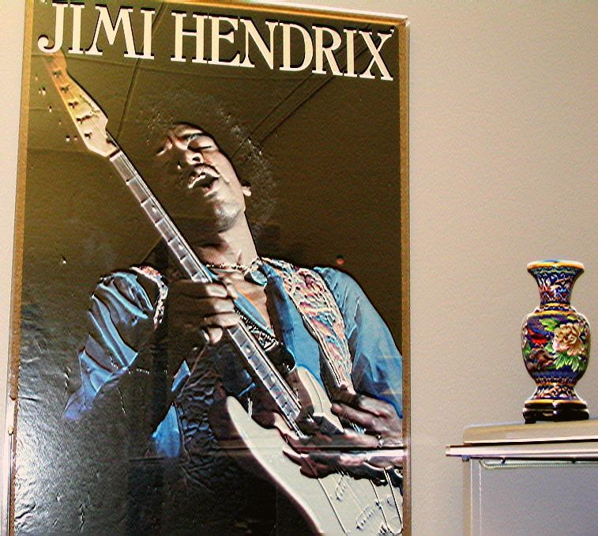
Difference Filter
Original image
Difference filtered image
Difference filtered image added to the original image, with contrast enhanced
DIP, Spring 2012 GS & AS, Bahria University, Islambad 35

Slide 35
Next slides are extra material for study!!!
DIP, Spring 2012 GS & AS, Bahria University, Islambad

Slide 36
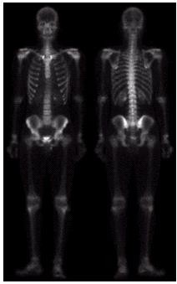
Combining Spatial Enhancement Methods
Successful image enhancement is
typically not achieved using a single
operation
Rather we combine a range of
techniques in order to achieve a final
result
This example will focus on enhancing
the bone scan
DIP, Spring 2012 GS & AS, Bahria University, Islambad

Slide 37

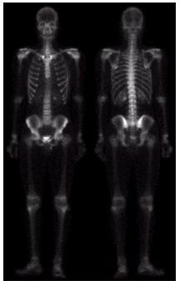
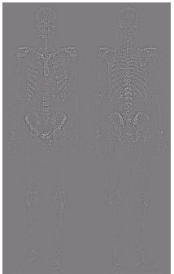
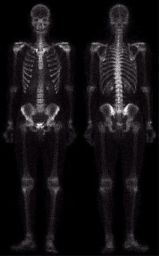
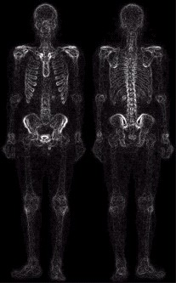
Combining Spatial Enhancement Methods
(a)
Laplacian filter of
bone scan (a)
(b)
Sharpened version of bone scan achieved by subtracting (a) and (b)
(c)
Sobel filter of bone scan (a)
(d)

Slide 38

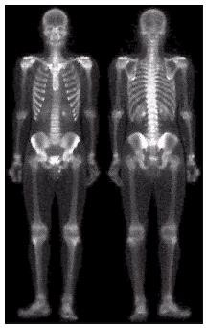
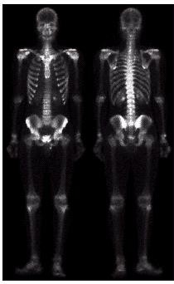
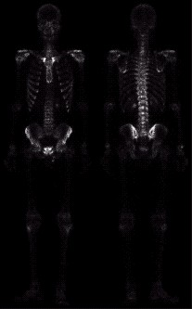
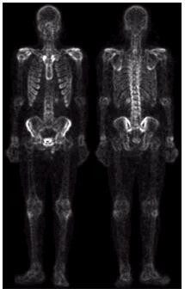
Combining Spatial Enhancement Methods
Result of applying a
power-law trans. to image (g)
(h)
Sharpened
which is sum of (a)
and (f)
(f)
(g)
The product of (c) and (e) which will be used as a mask
(e)
Image (d) smoothed with a 5*5 averaging filter

Slide 39
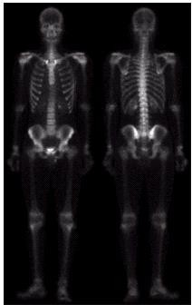
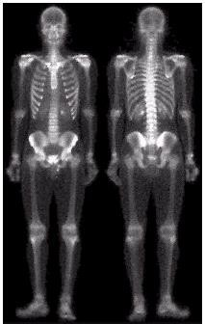
Combining Spatial Enhancement Methods
Compare the original and final images

